Slide 1
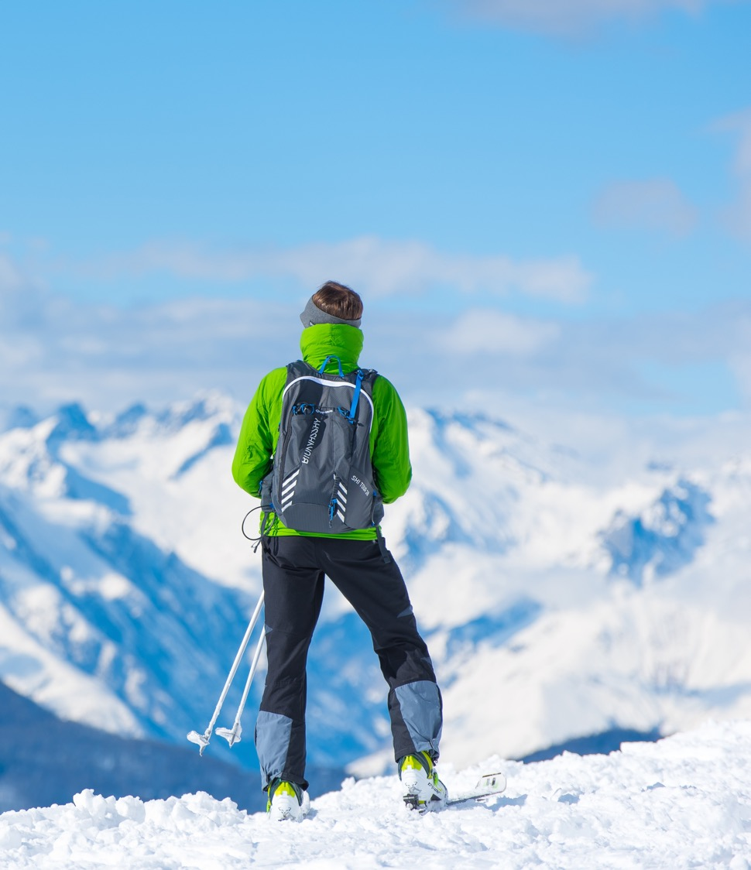
Big Mountain Resort
Nick’s BMR Presentation

Slide 2

How can revenue be increased
With over 350,000 skiers and snowboarders venture to hit the slopes of Big Mountain Resort every year. To help make traversing the 3000 skiable acres last year a new lift was added that increased the resorts operational costs by $1,540,000.
How can BMR cover these costs? Should changes be made to increase ticket prices, or are there other ways to cut overhead expenses elsewhere on the mountain.
Notes:
© Copyright Showeet.com – Free PowerPoint Templates

Slide 3
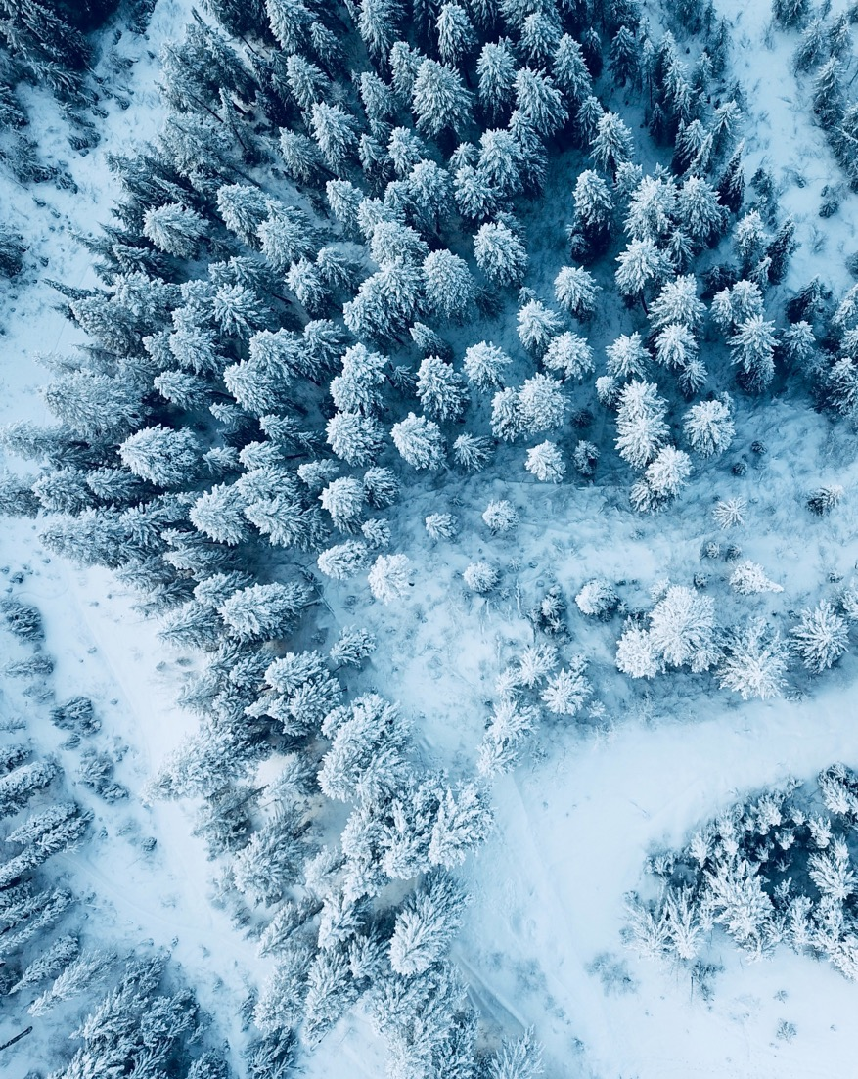
Turns out…Big Mountain has what it needs
Data gathered from ski resorts across the US have given us two ways to increase profits with a diversified approach that hits the problem from both sided.
On the revenue generating front, all that BRM has to offer when compared to other results in our modelling recommends it is undervalued and base ticket price should increase from $81.00 to $87.00.
On the other side of the coin, modelling shows that the five least used runs can be closed down to save on maintenance costs while still providing the available features to justify the price increase.
Notes:
© Copyright Showeet.com – Free PowerPoint Templates

Slide 4
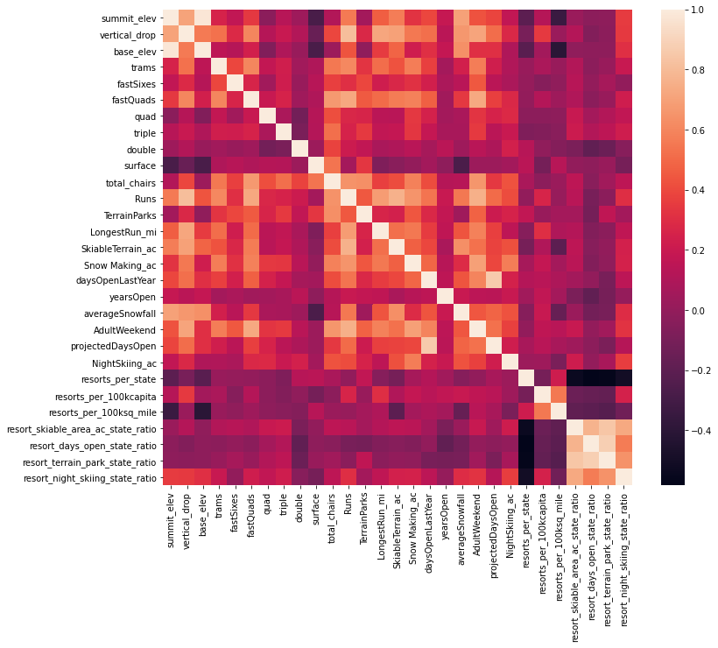
What Features are Important to a resort
Features Correlation
Initial Data collection showed that some features had very strong relationships with other features. While some are self evident others reveal some interesting finding such as the states with higher per capita have much higher levels of night skiing.

Slide 5
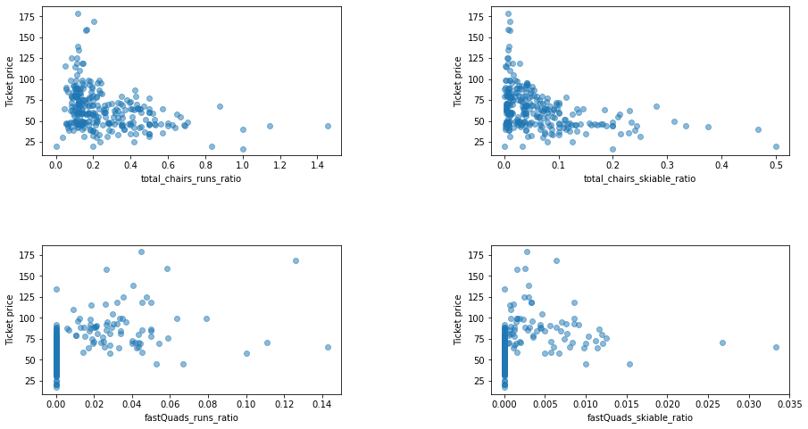
Quality over quanity
The Data pointed out that sometimes the expected results my be just the opposite as it seems that the more chairs a resort has to move people around, relative to the number of runs, ticket price rapidly plummets and stays low. What we may be seeing here is an exclusive vs. mass market resort effect.

Slide 6
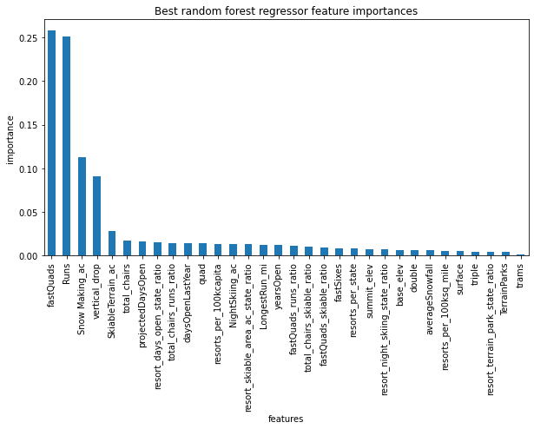
What Maters MOst
During the cross-validation and refining of or model four features were found to have the largest impact on tick price point
-Does the resort have fast quad lifts
-Total number of runs
-Snow making per acre
-Total vertical drop

Slide 7
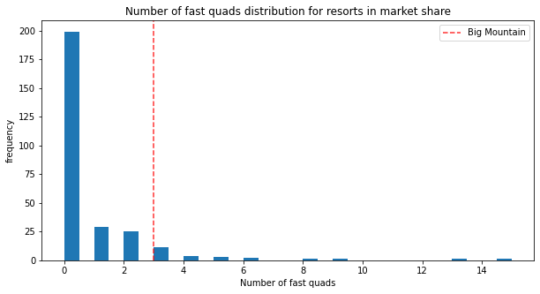
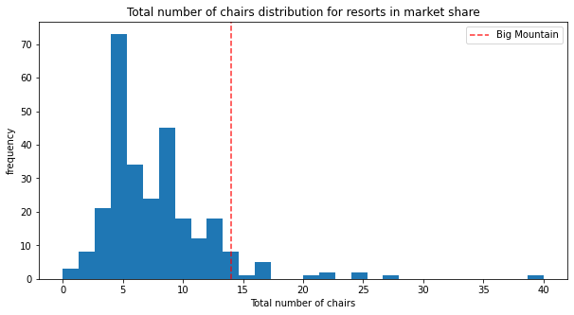
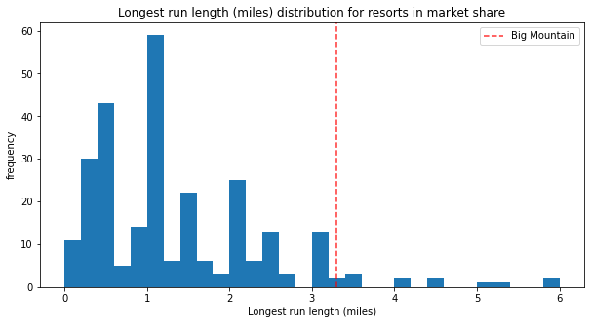
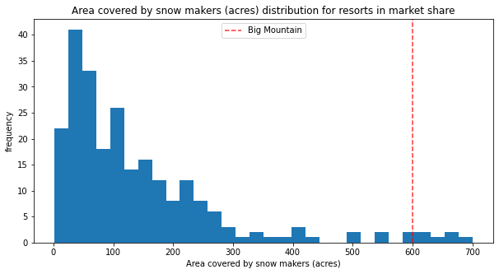
Top Features at Big Mountain

Slide 8
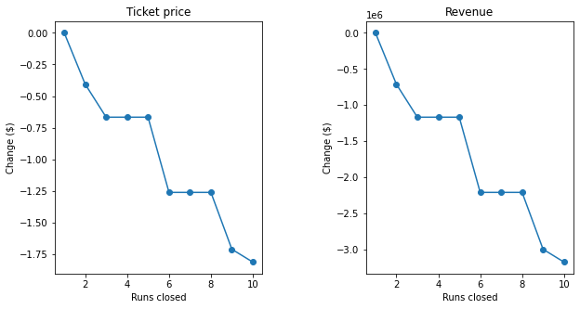
How to save on costs
When trying to look for ways BMR could save on overhead costs modelling was generated to check what (if any) was a number of rarely used runs could be closed. Models with 1-10 runs was simulated were modeled and revenue tended to drop sharply between 5 and 6.

Slide 9
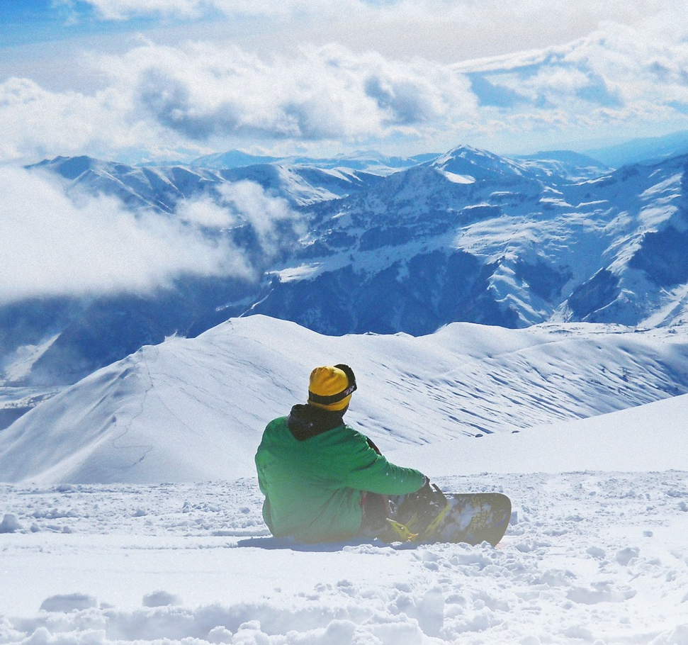
Conclusion
Big Mountain Resort really is an undervalued experience. By adjusting prices and reducing costs of runs the new operational costs for the new lift install last year can easily be offset.

